Slide 1
Game: Guess a Number
This project is a simple number guessing game where the user tries to guess a randomly generated number.
main( )
display_scores( )
read_history( )
get_player_name( )
repeat_game( )
store_name( )
Features:
Read history.txt file
Random number
User input
Too high / Too low
Loop until correct
Play again
Write in history.txt

Slide 2
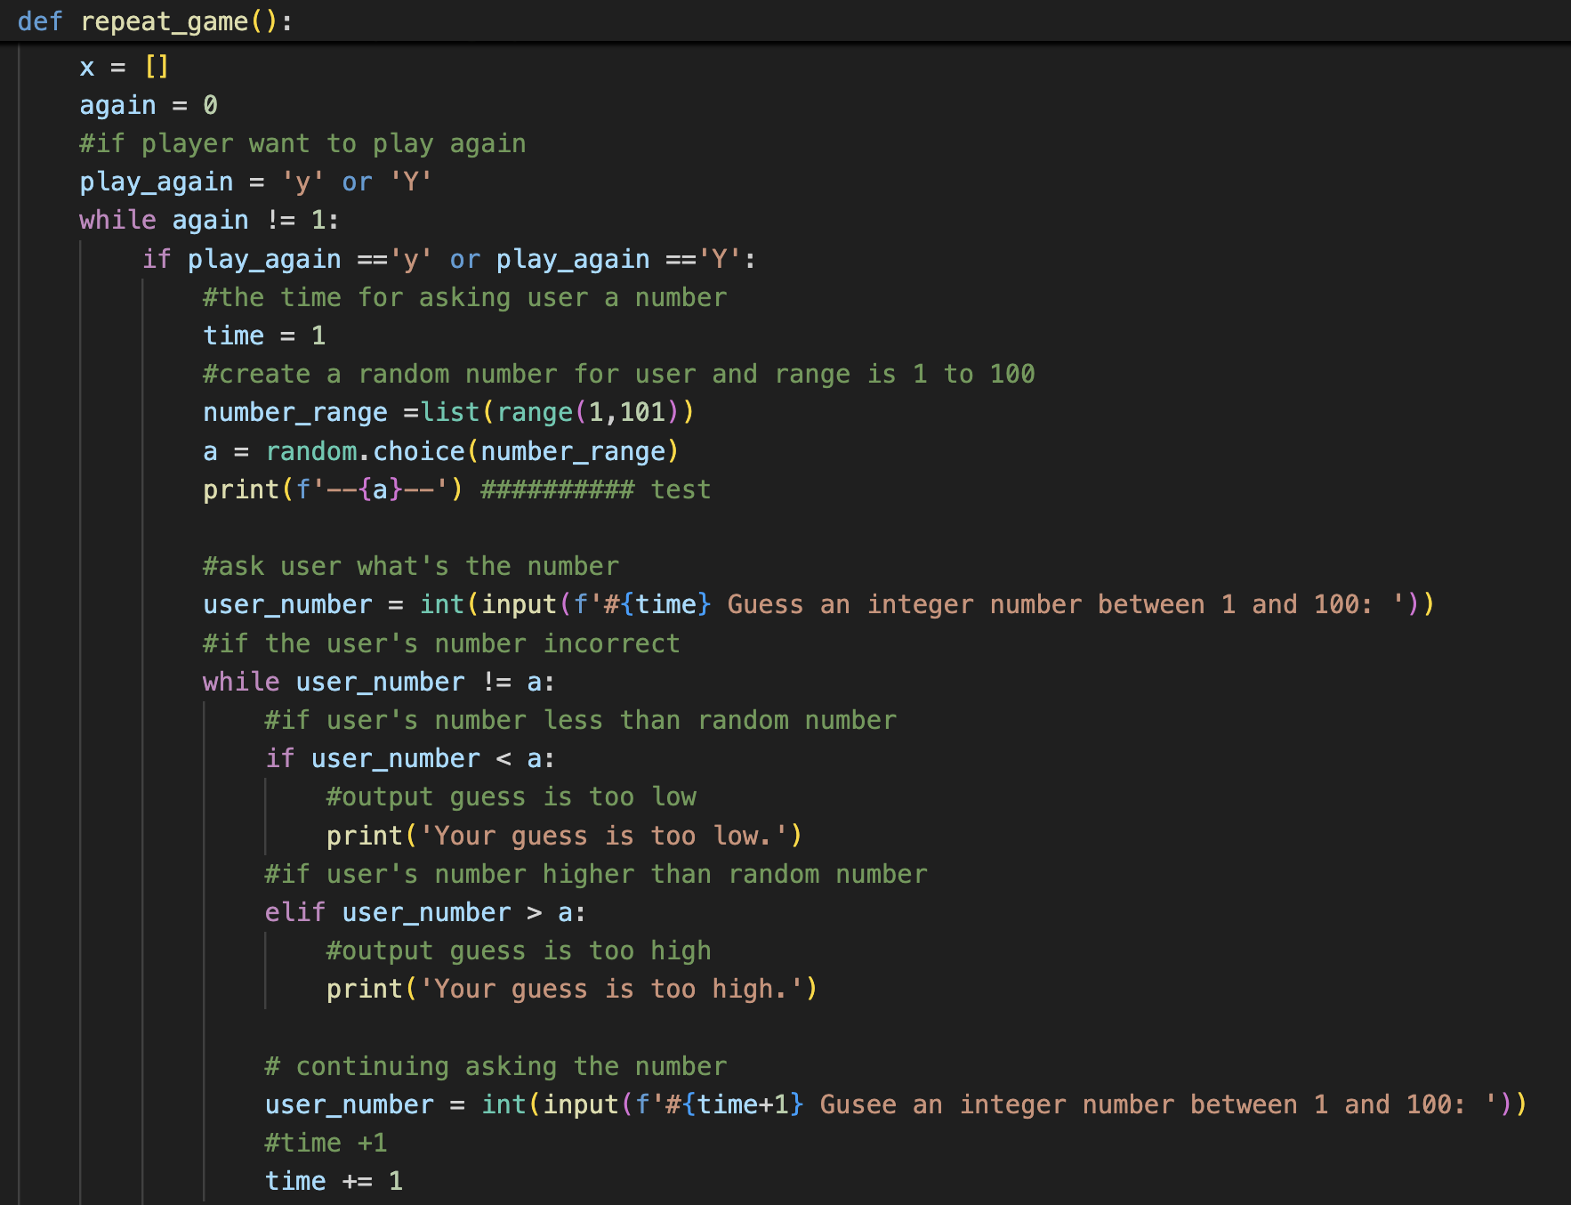
Code:
initialize again = 0, which starts the while loop
create a random number
for testing the result
Key Concepts:
Random module
while loop
if - else
deal with the incorrect numbers

Slide 3
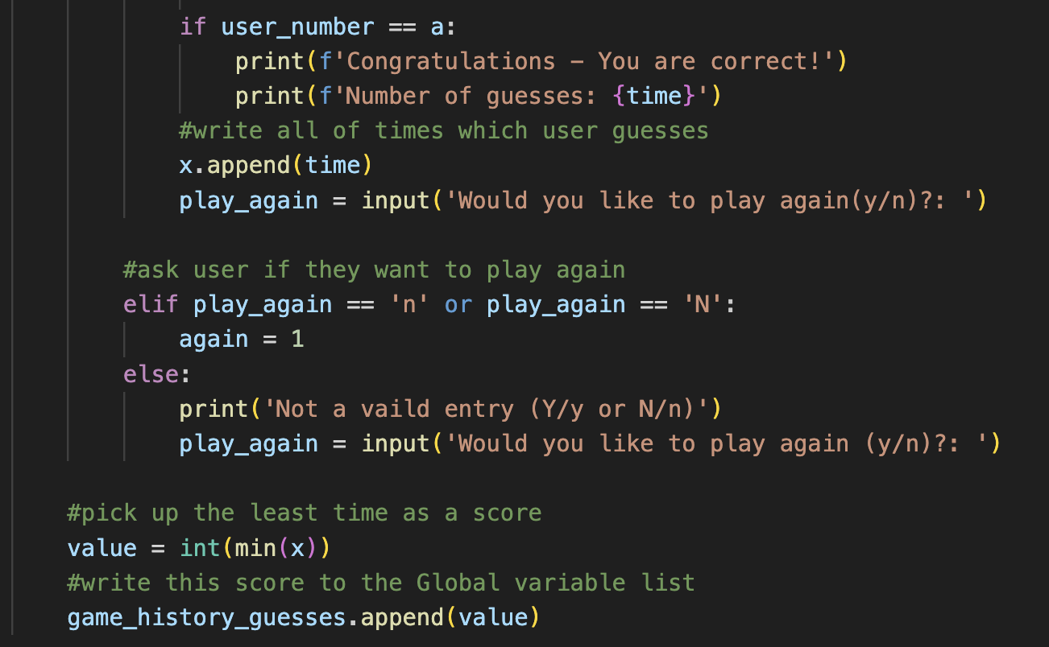
ask for playing again
stop the while loop
for the invalid input
get the best score for user

Slide 4
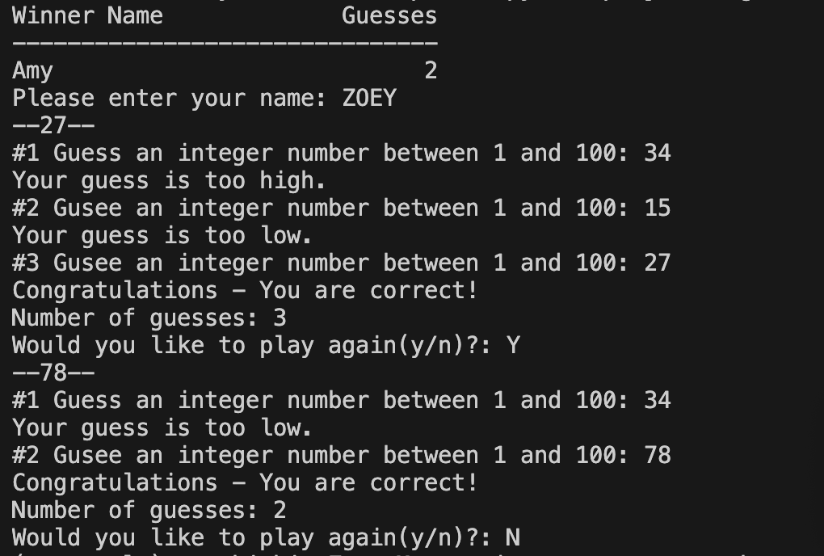
Run the Code
for testing the result

Slide 5
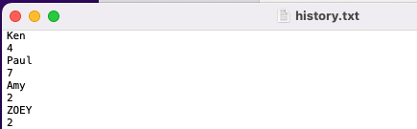

history.txt
ZOEY will be the winner:
new record

